Slide 1
Exam Preparation & Building a Computer
Exam Preparation, Multiplication Implementation Exercise, Building a Computer, Hack CPU Interface

Slide 2
Lecture Outline
Exam Preparation
  Study Strategies, Mock Exam Problem
Multiplication Implementation Exercise
  Multiplying Two Numbers in Hack Assembly
Building a Computer
  Architecture, Fetch and Execute Cycle
Hack CPU Interface
  Implementation and Operations

Slide 3
Exams Preparation Discussion
How do you usually prepare for your exams?
What is one thing that is effective and ineffective about the way you study? Why?
What are some effective exam preparation strategies that you would find most helpful?

Slide 4
Gearing Up For Exams
Make a Study Plan
  What key topics / concepts does your exam cover?
  How might your study guides look different for specific classes?
  What resources, materials, or people might you engage with?
Create a Schedule
  Avoid cramming
  Office hours, review sessions, study groups
  Reference your weekly time commitments & quarterly calendar
Test Yourself
  What are ways that can help address this?
  Replicate exam-like environments

Slide 5
Project 6, Part I: Mock Exam Problem
Schedule a 30-minute session based on your group members' availability to complete one mock exam problem
Determine how you will connect with each other and where your session will be located
Mock exam problem groups posted on the Ed board
  Please have one person from your group email Eric or respond on the Ed post with when your group will meet for the mock exam problem

Slide 6
Lecture Outline
Exam Preparation
  Study Strategies, Mock Exam Problem
Multiplication Implementation Exercise
  Multiplying Two Numbers in Hack Assembly
Building a Computer
  Architecture, Fetch and Execute Cycle
Hack CPU Interface
  Implementation and Operations

Slide 7
Hack: Registers
D Register: For storing Data
A Register: For storing data and Addressing memory
M “Register”: The 16-bit word in Memory currently being referenced by the address in A
RAM
1100101010010101
...
106
107
108
109
110
...
REGISTERS
M
A
108
D

Slide 8
Hack: A-Instructions
Syntax:
value can either be:
  A decimal constant
  A symbol referring to a constant
Semantics:
  Stores value in the A register
@value

Slide 9
Hack: A-Instructions
Symbolic Syntax
  Loads a value into the A register
Example:
Binary Syntax
@value
0000000000010101
Family:
A-Instruction
Value:
Binary encoding of 21
A Register
D Register
...
@21
...
0
0
A Register
D Register
21
0

Slide 10
Hack: Symbols
Symbols are simply an alias for some address
  Only in the symbolic code—don’t turn into a binary instruction
  Assembler converts use of that symbol to its value instead
Example:
LOOP = 02
00
01
02
03
04
@3
D=0
(LOOP)
@21
D=1
@LOOP
...
00
01
02
03
04
0000000000000011
1110101010010000
0000000000010101
1110111111010000
0000000000000010
...
Assemble

Slide 11
Hack: C-Instructions
Syntax: (dest and jump optional)
  dest is a combination of destination registers:
  comp is a computation:
  jump is an unconditional or conditional jump:
Semantics:
  Computes value of comp
  Stores results in dest (if specified)
  If jump is specified and condition is true (by testing comp result), jump to instruction ROM[A]
dest = comp ; jump
M, D, MD, A, AM, AD, AMD
0, 1, -1, D, A, !D, !A, -D, -A, D+1, A+1, D-1, A-1, D+A, D-A, A-D, D&A, D|A, M, !M, -M, M+1, M-1, D+M, D-M, M-D, D&M, D|M
JGT, JEQ, JGE, JLT, JNE, JLE, JMP

Slide 12
Hack: C-Instructions
Symbolic:
Binary:
dest = comp ; jump
1 1 1 a c1 c2 c3 c4 c5 c6 d1 d2 d3 j1 j2 j3
Family:
C-Instruction
Unused
Comp:
ALU Operation (a bit chooses between A and M)
Dest:
Where to store result
Jump:
Condition for jumping

Slide 13
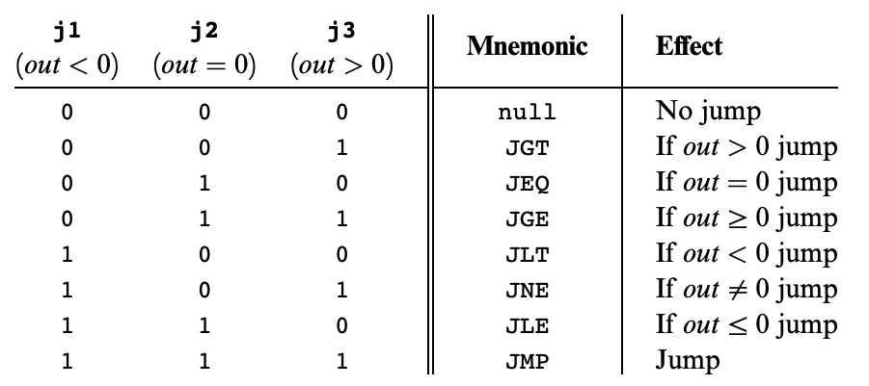
Hack: C-Instructions
Symbolic:
Binary:
dest = comp ; jump
1 1 1 a c1 c2 c3 c4 c5 c6 d1 d2 d3 j1 j2 j3
Jump:
Condition for jumping
Chapter 4

Slide 14
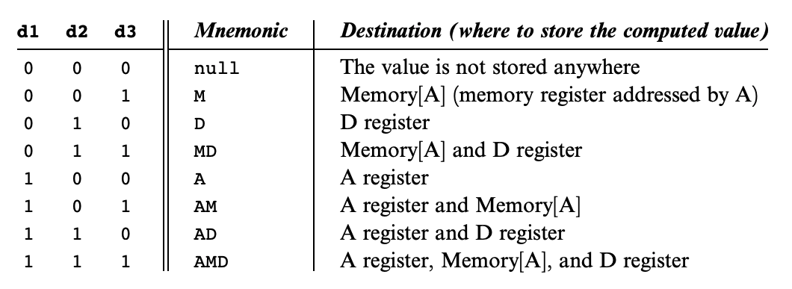
Hack: C-Instructions
Symbolic:
Binary:
dest = comp ; jump
1 1 1 a c1 c2 c3 c4 c5 c6 d1 d2 d3 j1 j2 j3
Dest:
Where to store result
Chapter 4

Slide 15
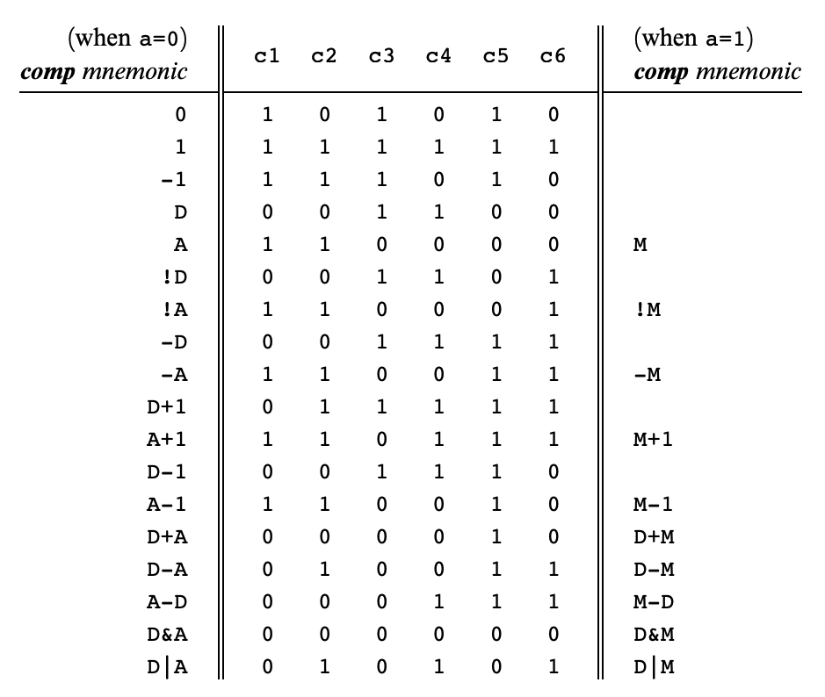
Hack: C-Instructions
Symbolic:
Binary:
dest = comp ; jump
1 1 1 a c1 c2 c3 c4 c5 c6 d1 d2 d3 j1 j2 j3
Comp:
ALU Operation (a bit chooses between A and M)
Chapter 4
Important: just pattern matching text!
Cannot have “1+M”

Slide 16
Exercise: Implementing Multiplication
Write a program that multiplies R0 and R1 and stores the result in R2
  Remember we don’t have a multiply operation
  We will have to use add and loops to get the job done
Roadmap
  Start with pseudocode using if statements, loops, etc.
  Remove conditionals and loops by using jumps in pseudocode
  Convert pseudocode to assembly

Slide 17
Exercise: Implementing Multiplication
Goal: Implement R0 × R1 = R2
Pseudocode | Hack Assembly

Slide 18
Exercise: Implementing Multiplication
Goal: Implement R0 × R1 = R2
Pseudocode | Hack Assembly
Approach: add R0 to the result R1 times

Slide 19
Exercise: Implementing Multiplication
Goal: Implement R0 × R1 = R2
Pseudocode | Hack Assembly
Approach: add R0 to the result R1 times
R2 = 0
while (R1 > 0) {
R2 = R0 + R2
R1 = R1 - 1
}

Slide 20
Exercise: Implementing Multiplication
Remove loops from pseudocode
Use labels to notate important sections of the code
Attempt 1: What happens when R1 is 0? What should happen?
START:
R2 = 0
LOOP:
R2 = R0 + R2
R1 = R1 - 1
IF R1 > 0 JMP LOOP
END:
INFINITE LOOP
R2 = 0
while (R1 > 0) {
R2 = R0 + R2
R1 = R1 - 1
}

Slide 21
Exercise: Implementing Multiplication
Remove loops from pseudocode
Use labels to notate important sections of the code
Attempt 1: What happens when R1 is 0? What should happen?
START:
R2 = 0
LOOP:
IF R1 <= 0
JMP to END
R2 = R0 + R2
R1 = R1 - 1
JMP LOOP
END:
INFINITE LOOP
R2 = 0
while (R1 > 0) {
R2 = R0 + R2
R1 = R1 - 1
}

Slide 22
Exercise: Implementing Multiplication
Convert to Hack Assembly
START:
R2 = 0
LOOP:
IF R1 <= 0
JMP to END
R2 = R0 + R2
R1 = R1 - 1
JMP LOOP
END:
INFINITE LOOP

Slide 23
Exercise: Implementing Multiplication
Convert to Hack Assembly
START:
R2 = 0
LOOP:
IF R1 <= 0
JMP to END
R2 = R0 + R2
R1 = R1 - 1
JMP LOOP
END:
INFINITE LOOP
(START)
@R2
M = 0
(LOOP)
(END)

Slide 24
Exercise: Implementing Multiplication
Convert to Hack Assembly
START:
R2 = 0
LOOP:
IF R1 <= 0
JMP to END
R2 = R0 + R2
R1 = R1 - 1
JMP LOOP
END:
INFINITE LOOP
(START)
@R2
M = 0
(LOOP)
@R1
D = M
@END
D; JLE
(END)

Slide 25
Exercise: Implementing Multiplication
Convert to Hack Assembly
(START)
@R2
M = 0
(LOOP)
@R1
D = M
@END
D; JLE
@R0
D = M
@R2
M = M + D
(END)
START:
R2 = 0
LOOP:
IF R1 <= 0
JMP to END
R2 = R0 + R2
R1 = R1 - 1
JMP LOOP
END:
INFINITE LOOP

Slide 26
Exercise: Implementing Multiplication
(START)
@R2
M = 0
(LOOP)
@R1
D = M
@END
D; JLE
@R0
D = M
@R2
M = M + D
@R1
M = M - 1
@LOOP
0; JMP
(END)
Convert to Hack Assembly
START:
R2 = 0
LOOP:
IF R1 <= 0
JMP to END
R2 = R0 + R2
R1 = R1 - 1
JMP LOOP
END:
INFINITE LOOP

Slide 27
Exercise: Implementing Multiplication
Convert to Hack Assembly
(START)
@R2
M = 0
(LOOP)
@R1
D = M
@END
D; JLE
@R0
D = M
@R2
M = M + D
@R1
M = M – 1
@LOOP
0; JMP
(END)
@END
0; JMP
START:
R2 = 0
LOOP:
IF R1 <= 0
JMP to END
R2 = R0 + R2
R1 = R1 - 1
JMP LOOP
END:
INFINITE LOOP

Slide 28
Lecture Outline
Exam Preparation
  Study Strategies, Mock Exam Problem
Multiplication Implementation Exercise
  Multiplying Two Numbers in Hack Assembly
Building a Computer
  Architecture, Fetch and Execute Cycle
Hack CPU Interface
  Implementation and Operations

Slide 29
Building a Computer
All your hardware efforts are about to pay off!
Perspective: BUILDING A COMPUTER
In Project 6, you will build Computer.hdl, the final, top-level chip in this course
  For all intents and purposes, a real computer
  Simplified, but organization very similar to your laptop
Project 7 onward, we will write software to make it useful

Slide 30

Von Neumann Architecture
COMPUTER
MEMORY
CPU
0
1
2
0101110011100110
1011000101010100
1110001011111100
...
Instructions
INPUT
OUTPUT
n
n+1
n+2
1100101010010101
1100100101100111
0011001010101011
...
Data
REGISTERS
CONTROL

Slide 31
Connecting the Computer: Buses
COMPUTER
MEMORY
CPU
0
1
2
0101110011100110
1011000101010100
1110001011111100
...
Instructions
INPUT
OUTPUT
n
n+1
n+2
1100101010010101
1100100101100111
0011001010101011
...
Data
REGISTERS
CONTROL
Control Bus
Address Bus
Data Bus

Slide 32
Basic CPU Loop
Repeat forever:
  Fetch an instruction from the program memory
  Execute that instruction

Slide 33
Fetching
Specify which instruction to read as the address input to our memory
Data output: actual bits of the instruction
MEMORY
Memory Output: Data
Instruction
D=A;JMP
0
1
2
0101110011100110
1011000101010100
1110001011111100
...
Instructions
n
n+1
n+2
1100101010010101
1100100101100111
0011001010101011
...
Data
Memory Input: Address
Instruction Address
PC
1

Slide 34
Executing
The instruction bits describe exactly “what to do”
  A-instruction or C-instruction?
  Which operation for the ALU?
  What memory address to read? To write?
  If I should jump after this instruction, and where?
Executing the instruction involves data of some kind
  Accessing registers
  Accessing memory

Slide 35
Combining Fetch & Execute
MEMORY
Memory Output: Data
Instruction
D=A;JMP
0
1
2
0101110011100110
1011000101010100
1110001011111100
...
Instructions
Data
245
n
n+1
n+2
1100101010010101
1100100101100111
0011001010101011
...
Data
Memory Input: Address
Instruction Address
PC
1
Data Address (From instruction or register)

Slide 36
Combining Fetch & Execute
MEMORY
Memory Output: Data
Could we implement with RAM16K.hdl?
  (Hint: Think about the I/O of RAM)
Instruction
D=A;JMP
0
1
2
0101110011100110
1011000101010100
1110001011111100
...
Instructions
Data
245
n
n+1
n+2
1100101010010101
1100100101100111
0011001010101011
...
Data
Memory Input: Address
Instruction Address
PC
1
Data Address (From instruction or register)

Slide 37
Combining Fetch & Execute
MEMORY
Memory Output: Data
Could we implement with RAM16K.hdl?
  No! Our memory chips only have one input and one output
Instruction
D=A;JMP
0
1
2
0101110011100110
1011000101010100
1110001011111100
...
Instructions
Data
245
n
n+1
n+2
1100101010010101
1100100101100111
0011001010101011
...
Data
Memory Input: Address
Instruction Address
PC
1
Data Address (From instruction or register)

Slide 38
Solution 1: Handling Single Input / Output
Memory Output: Data
Instruction, when fetching
Can use multiplexing to share a single input or output
MEMORY
0
1
2
0101110011100110
1011000101010100
1110001011111100
...
Instructions
DMux
Data, when executing
n
n+1
n+2
1100101010010101
1100100101100111
0011001010101011
...
Data
Memory Input: Address
Instruction Address
Mux
Data Address
Fetching vs. Executing

Slide 39
Solution 1: Fetching / Executing Separately
Fetching vs. Executing
Memory Output: Data
Instruction, when fetching
Need to store fetched instruction so it’s available during execution phase
MEMORY
Register
0
1
2
0101110011100110
1011000101010100
1110001011111100
...
Instructions
DMux
Data, when executing
n
n+1
n+2
1100101010010101
1100100101100111
0011001010101011
...
Data
Memory Input: Address
Instruction Address
Mux
Data Address
Fetching vs. Executing

Slide 40
Solution 2: Separate Memory Units
Separate instruction memory and data memory into two different chips
  Each can be independently addressed, read from, written to
Pros:
  Simpler to implement
Cons:
  Fixed size of each partition, rather than flexible storage
  Two chips → redundant circuitry

Slide 41
Lecture Outline
Exam Preparation
  Study Strategies, Mock Exam Problem
Multiplication Implementation Exercise
  Multiplying Two Numbers in Hack Assembly
Building a Computer
  Architecture, Fetch and Execute Cycle
Hack CPU Interface
  Implementation and Operations

Slide 42
Hack CPU
COMPUTER
ROM
(Instructions)
CPU
RAM
(Data)
instr
data out
0
1
2
010111001110
101100010101
111000101111
...
Instructions
0
1
2
100110010111
100011001111
000000000010
...
Data
addr of next instruction
REGISTERS
data in
CONTROL
INPUT
OUTPUT

Slide 43
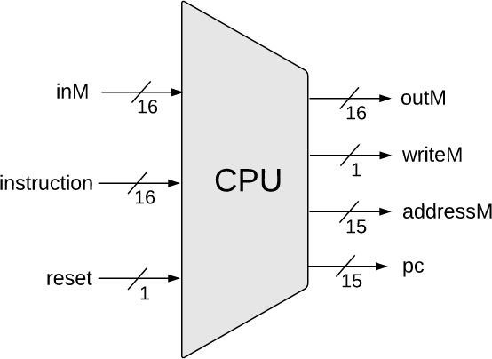
Hack CPU Interface Inputs
inM: Value coming from memory
instruction: 16-bit instruction
reset: if 1, reset the program

Slide 44
Hack CPU Interface Outputs
outM: value used to update memory if writeM is 1
writeM: if 1, update value in memory at addressM with outM
addressM: address to read from or write to in memory
pc: address of next instruction to be fetched from memory

Slide 45
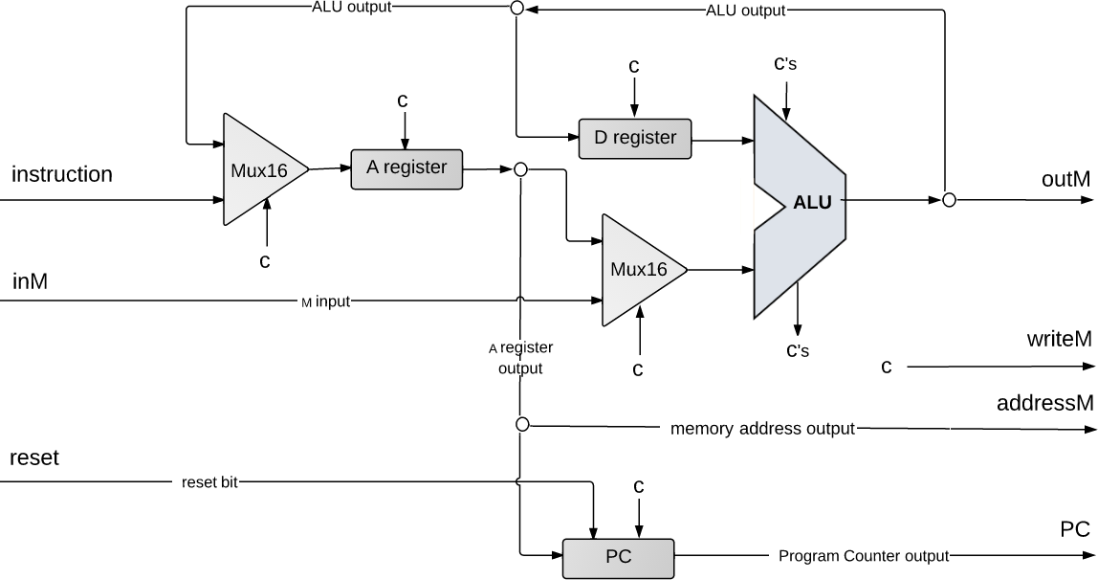
Hack CPU Implementation
Diving beneath the hood… next lecture!
pc

Slide 46
Lecture 9 Reminders
Project 5 due this Friday (2/2) at 11:59pm
Midterm exam coming up on 2/9 during lecture time
Amy has office hours tomorrow at 1:30pm in CSE2 151
  Feel free to post your questions on the Ed board as well

